Slide 1


Basics of Data Structures
ETCCBD201
Ms. Jyoti Yadav
Faculty
School of Engineering & Technology
K.R. Mangalam University
Unit 2 : Linear Data Structures

Slide 2

Unit-2 Linear Data Structures
SESSION 11 Arrays – 1D & 2D
SESSION 12 Static & Dynamic Arrays
SESSION 13 Linked Lists Types
SESSION 14 Linked List Operations
SESSION 15 Stack ADT & Operations
SESSION 16 Stack Applications
SESSION 17 Queue ADT
SESSION 18 Queue Applications
SESSION 19 BFS using Queue
SESSION 20 Revision (Unit–2)
Notes:
New Courses replaced with New Programmes

Slide 3
Linked List Operations
Session 14
Introduction to Linked List Operations
Singly Linked List Representation
Traversal Operation
Insertion Operations
Deletion Operations
Search Operation
Time Complexity Analysis
Advantages and Disadvantages
Practice Questions
Common Errors
Key Takeaways
Quick Quiz
References
Notes:
New Courses replaced with New Programmes

Slide 4
Learning Objectives
After this lecture, students will be able to:
Explain basic operations performed on a linked list
Perform traversal, insertion, deletion, and search operations
Write and understand algorithms and code for linked list operations
Analyze time complexity of different linked list operations
Identify common errors while performing pointer manipulations
Notes:
New Courses replaced with New Programmes

Slide 5
Recapitulation (Linked List Types)
A linked list is a linear data structure made up of nodes, where each node contains data and pointer(s).
Unlike arrays, linked lists store elements in non-contiguous memory locations.
The head points to the first node, and the last node points to NULL (except in circular lists).
Singly linked lists use one pointer and support forward traversal only.
Doubly linked lists use two pointers and support forward and backward traversal.
Circular linked lists do not have NULL pointers; the last node points back to the head.
Linked lists provide dynamic memory allocation and efficient insertion and deletion operations.
Notes:
New Courses replaced with New Programmes

Slide 6
Quick Quiz
Fill in the Blanks
A linked list is composed of a series of connected __________.
Each node of a singly linked list contains __________ pointer(s).
In a circular linked list, the last node points to the __________.
A doubly linked list supports __________ traversal.
Linked lists store elements in __________ memory locations.
One-Word Answer Questions
Pointer to the first node of a linked list
Linked list that supports backward traversal
Linked list with no NULL pointer
Notes:
New Courses replaced with New Programmes

Slide 7
Quick Quiz (Answers)
Nodes
One
Head
Bidirectional
Non-contiguous
Head
Doubly
Circular
Notes:
New Courses replaced with New Programmes

Slide 8
Linked List Operations
The basic operations on a linked list are:
Traversal: Visiting every element and displaying it
Insertion: Add a new element to the list
At the beginning
At the end
After another node
Deletion: Removing an item from a list
From the beginning
From the end
Delete node after a given node
Search: The supplied key is used to search element
Notes:
New Courses replaced with New Programmes

Slide 9
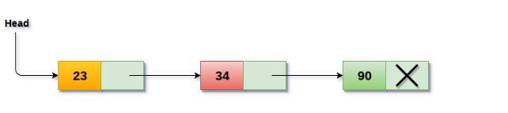
Singly linked list Representation
Node Linking: Nodes are linked sequentially through pointers. Each node's pointer points to the next node in the sequence, forming the linkage.
Memory Allocation: Typically, dynamic memory allocation is used for node creation, allowing nodes to be created and destroyed as needed.
Access: Access to elements in a singly linked list starts from the head pointer. To access or manipulate data in a specific node, traversal through the list from the head pointer is necessary.
Notes:
New Courses replaced with New Programmes

Slide 10
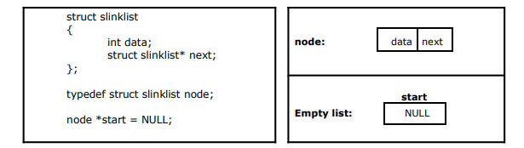
Implementation of Single Linked List
We need to create a start node, used to create and access other nodes in the linked list.
The following structure definition will do:
Creating a structure with one data item and a next pointer, which will be pointing to next node of the list. This is called as self-referential structure.
Initialise the start pointer to be NULL
Notes:
New Courses replaced with New Programmes

Slide 11
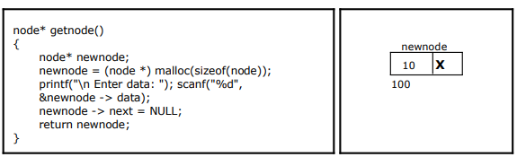
Creating a node for Single Linked List
Notes:
New Courses replaced with New Programmes

Slide 12
Traversal operation
Traversal is the process of visiting each node of the linked list exactly once to access or display data.
Traversal starts from head and continues until NULL.
Algorithm: Traverse Linked List
Start from head
If head is NULL, stop
Print the data of current node
Move to the next node
Repeat until current node becomes NULL
Notes:
New Courses replaced with New Programmes

Slide 13
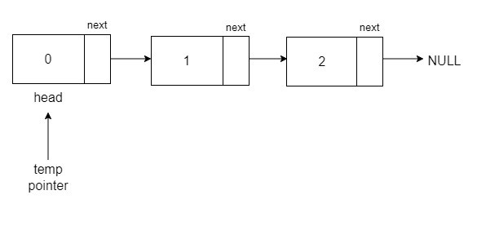
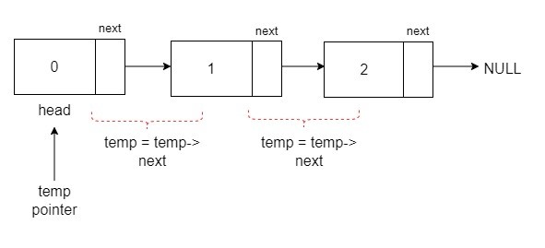
Traversal Operations
Notes:
New Courses replaced with New Programmes

Slide 14
Algorithm
STEP 1: SET PTR = HEAD
STEP 2: IF PTR = NULL
WRITE "EMPTY LIST" GOTO STEP 7 END OF IF
STEP 4: REPEAT STEP 5 AND 6 UNTIL PTR != NULL
STEP 5: PRINT PTR→ DATA
STEP 6: PTR = PTR → NEXT
[END OF LOOP]
STEP 7: EXIT
Code for traversing :
struct node *temp = head; printf("\n\nList elements are - \n");
while(temp != NULL) {
printf("%d --->",temp->data);
temp = temp->next; }
Complete code here.
Notes:
New Courses replaced with New Programmes

Slide 15
Traversal explanation
A temporary pointer is used to move through the list
Each node’s data is accessed sequentially
Traversal stops when NULL is reached
Time Complexity: O(n)
Notes:
New Courses replaced with New Programmes

Slide 16
Traversal Code
Traversal – C Code | Traversal – Python Code
void traverse(struct node* head) { struct node* temp = head; while (temp != NULL) { printf("%d -> ", temp->data); temp = temp->next; } } | def traverse(head): temp = head while temp: print(temp.data, end=" -> ") temp = temp.next
Notes:
New Courses replaced with New Programmes

Slide 17
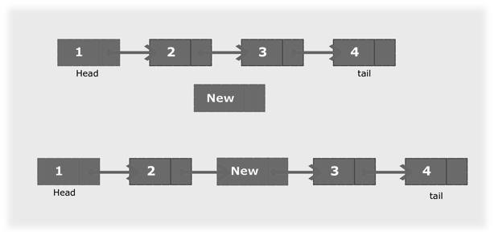
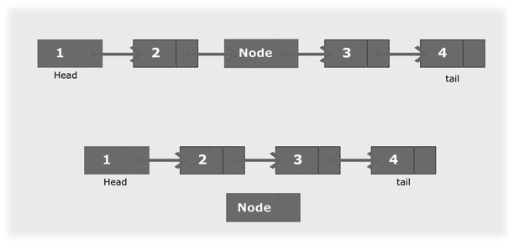
Insertion and Deletion operations on Singly Linked List
Insertion
Deletion
Notes:
New Courses replaced with New Programmes

Slide 18
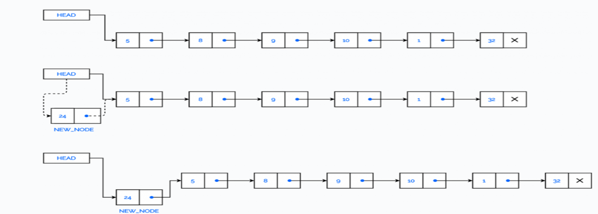
Insertion Operations
At the beginning.
At the end.
At Location node
Notes:
New Courses replaced with New Programmes

Slide 19
Insertion Operations at the beginning
Insertion at beginning means adding a new node before the current head.
Fastest insertion operation.
Notes:
New Courses replaced with New Programmes

Slide 20
Insertion at Beginning – Algorithm
Algorithm: Insert at Beginning
Create a new node
Assign data to new node
Set newNode.next = head
Update head = newNode
Notes:
New Courses replaced with New Programmes

Slide 21
Algorithm: Insert At Beginning
Step 1: IF AVAIL = NULL
Write OVERFLOW
Go to Step 7 [END OF IF]
Step 2: SET NEW_NODE = AVAIL
Step 3: SET AVAIL = AVAIL -> NEXT
Step 4: SET NEW_NODE -> DATA = VAL
Step 5: SET NEW_NODE -> NEXT = HEAD
Step 6: SET HEAD = NEW_NODE
Step 7: EXIT
Notes:
New Courses replaced with New Programmes

Slide 22
Insertion at Beginning – Algorithm
Insertion at Beginning – Explanation
New node becomes the first node
Head pointer is updated
No traversal required
Time Complexity: O(1)
Notes:
New Courses replaced with New Programmes

Slide 23
Code for node insertion
void LinkedList::insertFront(int data){
Node* new_node = new Node();
// assign data value
new_node->data = data;
// change the next node of this new_node
// to current head of Linked List
new_node->next = head;
Complete code here.
Notes:
New Courses replaced with New Programmes

Slide 24
Insertion at beginning Codes- C and Python
Insertion at Beginning – C Code | Insertion at Beginning – Python Code
struct node* insert_begin(struct node* head, int value) { struct node* newNode = (struct node*)malloc(sizeof(struct node)); newNode->data = value; newNode->next = head; return newNode; } | def insert_begin(head, value): new_node = Node(value) new_node.next = head return new_node
Notes:
New Courses replaced with New Programmes

Slide 25
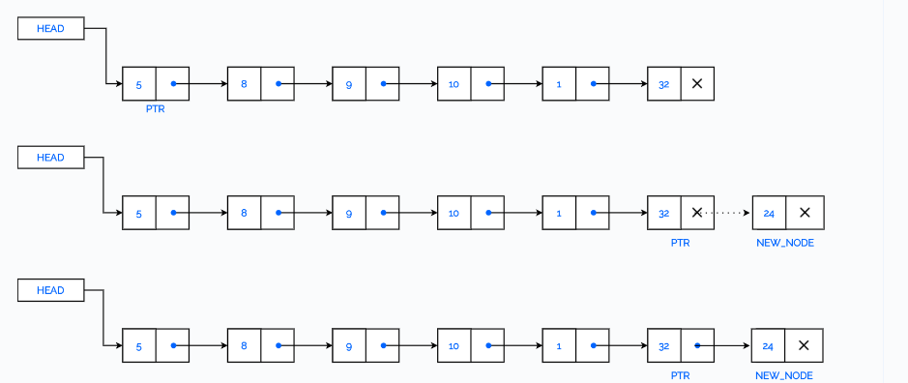
Insertion at End
Insertion at end means adding a new node after the last node.
Requires traversal.
Notes:
New Courses replaced with New Programmes

Slide 26
Insertion at End – Algorithm
Algorithm: Insert at End
Create a new node
Assign data and set next = NULL
If head is NULL, make new node the head
Traverse to the last node
Set last node’s next to new node
Notes:
New Courses replaced with New Programmes

Slide 27
Algorithm: Insert At End
Step 1: IF AVAIL = NULL
Write OVERFLOW
Go to Step 10 [END OF IF]
Step 2: SET NEW_NODE = AVAIL
Step 3: SET AVAIL = AVAIL -> NEXT
Step 4: SET NEW_NODE -> DATA = VAL
Step 5: SET NEW_NODE -> NEXT = NULL
Step 6: SET PTR = HEAD
Step 7: Repeat Step 8 while PTR -> NEXT != NULL Step
Step 8: SET PTR = PTR -> NEXT [END OF LOOP]
Step 9: SET PTR -> NEXT = NEW_NODE
Step 10: EXIT
Notes:
New Courses replaced with New Programmes

Slide 28
Insertion at End – Explanation
Traversal is required to reach last node
Pointer of last node is updated
Time Complexity: O(n)
Notes:
New Courses replaced with New Programmes

Slide 29
Code
void LinkedList::insertLast(int data)
{
Node* freshNode = new Node();
freshNode->data = data;
// since this will be the last node so it will point to NULL
freshNode->next = NULL;
//need this if there is no node present in linked list at all
if(head==NULL)
{
head = freshNode;
cout << freshNode->data << " inserted" << endl;
return;
}
struct Node* temp = head;
// traverse to the last node of Linked List
while(temp->next!=NULL)
temp = temp->next;
// assign last node's next to this freshNode
temp->next = freshNode;
cout << freshNode->data << " inserted" << endl;
}
Complete Code here
Notes:
New Courses replaced with New Programmes

Slide 30
Insertion at End Codes- C and Python
Insertion at End – C Code | Insertion at End – Python Code
struct node* insert_end(struct node* head, int value) { struct node* newNode = (struct node*)malloc(sizeof(struct node)); newNode->data = value; newNode->next = NULL; if (head == NULL) return newNode; struct node* temp = head; while (temp->next != NULL) temp = temp->next; temp->next = newNode; return head; | def insert_end(head, value): new_node = Node(value) if head is None: return new_node temp = head while temp.next: temp = temp.next temp.next = new_node return head
Notes:
New Courses replaced with New Programmes

Slide 31
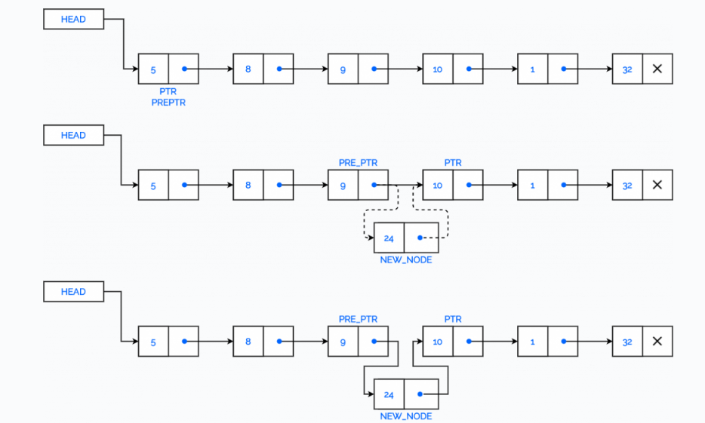
Insert a Node after a given Node in a Linked list
Notes:
New Courses replaced with New Programmes

Slide 32
Algorithm: Insert After An Element
Step 1: IF AVAIL = NULL Write OVERFLOW Go to Step 12 [END OF IF]
Step 2: SET NEW_NODE = AVAIL
Step 3: SET AVAIL = AVAIL -> NEXT
Step 4: SET NEW_NODE -> DATA = VAL
Step 5: SET PTR = HEAD
Step 6: SET PREPTR = PTR
Step 7: Repeat Steps 8 and 9 while PREPTR -> DATA != NUM
Step 8: SET PREPTR = PTR
Step 9: SET PTR = PTR -> NEXT [END OF LOOP]
Step 10 : PREPTR -> NEXT = NEW_NODE
Step 11: SET NEW_NODE -> NEXT = PTR
Step 12: EXIT
Notes:
New Courses replaced with New Programmes

Slide 33
Check Your Understanding
Traversal of a linked list always starts from the __________ node.
Insertion at the beginning of a linked list requires updating the __________ pointer.
Which insertion operation does not require traversal?
What will be the time complexity of inserting a node at the beginning of a linked list?
Notes:
New Courses replaced with New Programmes

Slide 34
Check Your Understanding (Answers)
Head
Head
Insertion at beginning
O(1)
Notes:
New Courses replaced with New Programmes

Slide 35
Deleting Elements from a Linked List
The first node is deleted.
The last node is deleted.
The node after a given node is deleted
Notes:
New Courses replaced with New Programmes

Slide 36
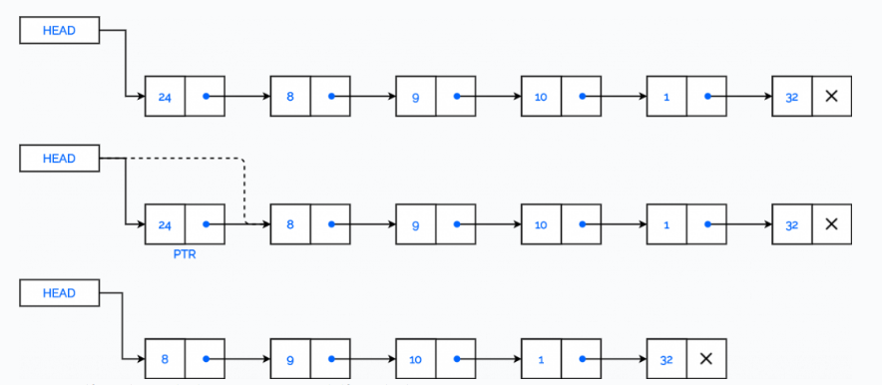
Deleting First Element from a Linked List
Deletion from beginning removes the first node of the linked list.
Notes:
New Courses replaced with New Programmes

Slide 37
Deletion from Beginning – Algorithm
Algorithm: Delete from Beginning
If head is NULL, stop
Store head in a temporary variable
Update head to head.next
Delete temporary node
Notes:
New Courses replaced with New Programmes

Slide 38
Algorithm: Delete From Beginning
Step 1: IF HEAD = NULL
Write UNDERFLOW
Go to Step 5 [END OF IF]
Step 2: SET PTR = HEAD
Step 3: SET HEAD = HEAD -> NEXT
Step 4: FREE PTR
Step 5: EXIT
Notes:
New Courses replaced with New Programmes

Slide 39
Deletion from Beginning – Explanation
Head is moved to the next node
Old head node is removed
Time Complexity: O(1)
Notes:
New Courses replaced with New Programmes

Slide 40
Deletion from Beginning Codes- C and Python
Deletion from Beginning – C Code | Deletion from Beginning – Python Code
struct node* delete_begin(struct node* head) { if (head == NULL) return NULL; struct node* temp = head; head = head->next; free(temp); return head; } | def delete_begin(head): if head is None: return None return head.next
Notes:
New Courses replaced with New Programmes

Slide 41
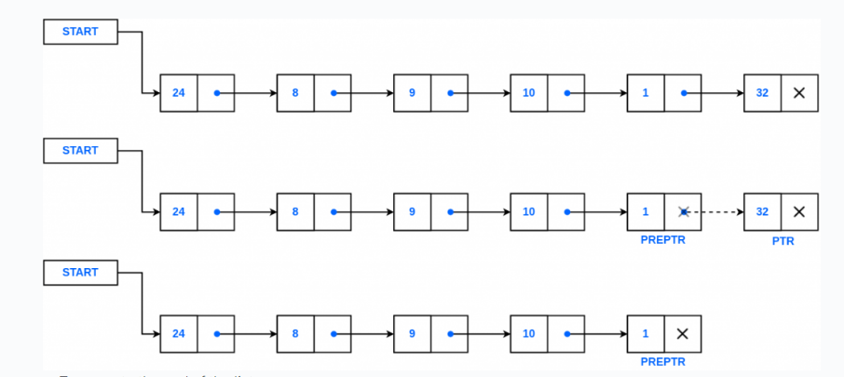
Deletion from End of a Linked list
Deletion from end removes the last node of the linked list.
Notes:
New Courses replaced with New Programmes

Slide 42
Deletion from End – Algorithm
Algorithm: Delete from End
If head is NULL, stop
If only one node exists, delete it and set head to NULL
Traverse to second last node
Delete last node
Set second last node’s next = NULL
Notes:
New Courses replaced with New Programmes

Slide 43
Algorithm: Delete From End
Step 1: IF HEAD = NULL Write UNDERFLOW Go to Step 8 [END OF IF]
Step 2: SET PTR = HEAD
Step 3: Repeat Steps 4 and 5 while PTR -> NEXT != NULL
Step 4: SET PREPTR = PTR
Step 5: SET PTR = PTR -> NEXT [END OF LOOP]
Step 6: SET PREPTR -> NEXT = NULL
Step 7: FREE PTR
Step 8: EXIT
Notes:
New Courses replaced with New Programmes

Slide 44
Deletion from End – Explanation
Traversal is required
Pointer of second last node is updated
Time Complexity: O(n)
Notes:
New Courses replaced with New Programmes

Slide 45
Deletion from End Codes- C and Python
Deletion from End – C Code | Deletion from End – Python Code
struct node* delete_end(struct node* head) { if (head == NULL || head->next == NULL) return NULL; struct node* temp = head; while (temp->next->next != NULL) temp = temp->next; free(temp->next); temp->next = NULL; return head; } | def delete_end(head): if head is None or head.next is None: return None temp = head while temp.next.next: temp = temp.next temp.next = None return head
Notes:
New Courses replaced with New Programmes

Slide 46
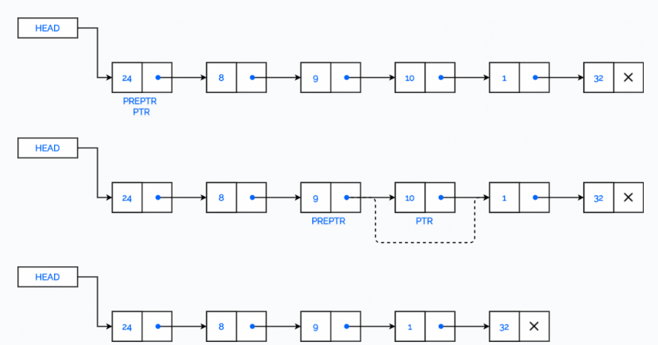
Delete the Node after a given Node
Notes:
New Courses replaced with New Programmes

Slide 47
Algorithm: Delete After A Node
Step 1: IF HEAD = NULL Write UNDERFLOW Go to Step 10 [END OF IF]
Step 2: SET PTR = HEAD
Step 3: SET PREPTR = PTR
Step 4: Repeat Steps 5 and 6 while PREPTR -> DATA != NUM
Step 5: SET PREPTR = PTR
Step 6: SET PTR = PTR -> NEXT [END OF LOOP]
Step 7: SET TEMP = PTR
Step 8: SET PREPTR -> NEXT = PTR -> NEXT
Step 9: FREE TEMP
Step 10 : EXIT
Notes:
New Courses replaced with New Programmes

Slide 48
Code
void del(node *before_del)
{
if (before_del == NULL || before_del->next == NULL)
return;
node* temp = before_del->next;
before_del->next = temp->next;
delete temp;
}
Complete code here
Notes:
New Courses replaced with New Programmes

Slide 49
Check Your Understanding
Which node is removed during deletion from the beginning of a linked list?
Deletion from the end of a singly linked list requires locating the __________ node.
What happens if deletion is attempted on an empty linked list?
What is the time complexity of deleting the last node in a singly linked list?
Notes:
New Courses replaced with New Programmes

Slide 50
Check Your Understanding (Answers)
First (head) node
Second last
No deletion is performed / list remains empty
O(n)
Notes:
New Courses replaced with New Programmes

Slide 51
Search
Algorithm:
Step 1: [INITIALIZE] SET PTR = HEAD
Step 2: Repeat Steps 3 and 4 while PTR != NULL
Step 3: If ITEM = PTR -> DATA SET POS = PTR Go To Step 5 ELSE SET PTR = PTR -> NEXT [END OF IF] [END OF LOOP]
Step 4: SET POS = NULL
Step 5: EXIT
Notes:
New Courses replaced with New Programmes

Slide 52
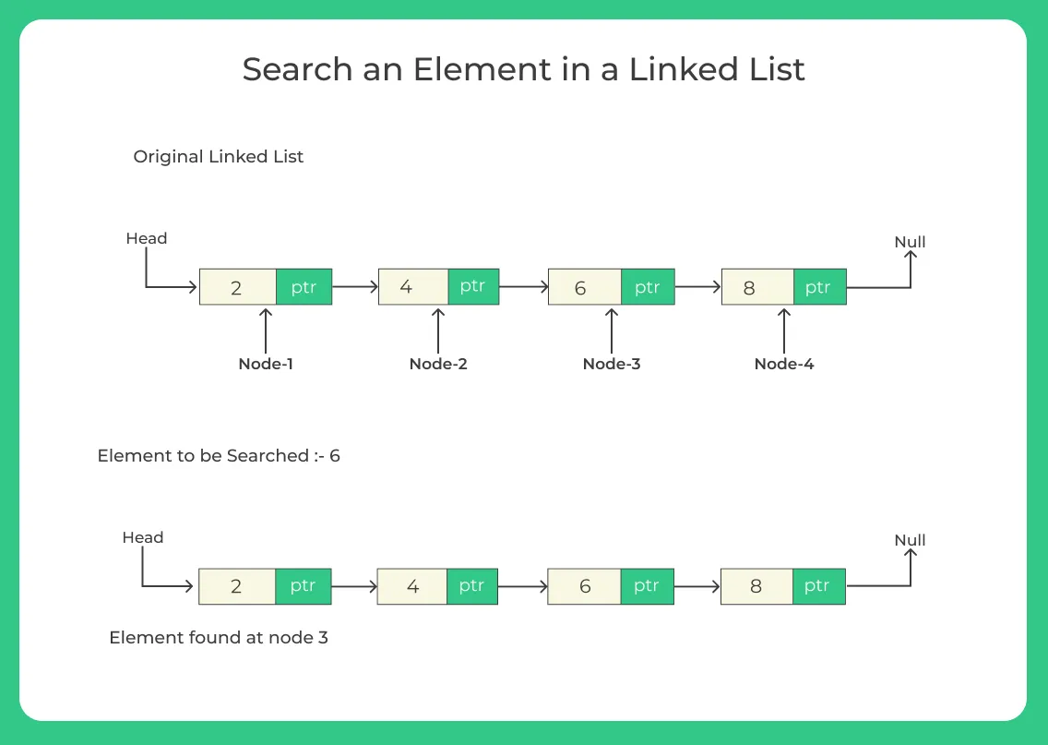
Search
Notes:
New Courses replaced with New Programmes

Slide 53
Time Complexity Summary
Operation | Time Complexity
Traversal | O(n)
Insert at Beginning | O(1)
Insert at End | O(n)
Delete at Beginning | O(1)
Delete at End | O(n)
Notes:
New Courses replaced with New Programmes

Slide 54
Singly Linked List
Data Structure | Time Complexity |  |  |  |  |  |  |  | Space Complexity
 | Average |  |  |  | Worst |  |  |  | Worst
 | Access | Search | Insertion | Deletion | Access | Search | Insertion | Deletion
Singly Linked List | θ(n) | θ(n) | θ(1) | θ(1) | O(n) | O(n) | O(1) | O(1) | O(n)
Notes:
New Courses replaced with New Programmes

Slide 55
Check Your Understanding
❓ Which operation is fastest in a linked list? ❓ Why is insertion at end slower than insertion at beginning?
Notes:
New Courses replaced with New Programmes

Slide 56
Check Your Understanding (Answers)
❓ Which operation is fastest in a linked list?
Insertion or deletion at the beginning is the fastest operation because it does not require traversal.
❓ Why is insertion at end slower than insertion at beginning?
Insertion at the end is slower because the list must be traversed to reach the last node before inserting the new node.
Notes:
New Courses replaced with New Programmes

Slide 57
Advantages
Efficient Insertion and Deletion: Adding or removing elements at the beginning or middle of the list is efficient, requiring only adjustments to pointers.
Dynamic Size: Singly linked lists can grow or shrink dynamically, as nodes can be added or removed without requiring contiguous memory allocation.
Flexibility: Singly linked lists have no fixed size limitations, offering flexibility in managing varying amounts of data
Notes:
New Courses replaced with New Programmes

Slide 58
Disadvantages
No Direct Access: Access to specific elements in the list requires traversal from the head pointer, making direct access inefficient.
Extra Memory Overhead: Each node in the list requires additional memory for storing pointers, leading to higher memory overhead compared to arrays.
Inefficient Reverse Traversal: Singly linked lists are inefficient for operations requiring access to nodes in reverse order, as they don't have pointers to previous nodes.
Notes:
New Courses replaced with New Programmes

Slide 59
Practice Questions
Insert a node at position 3
Delete a node with given value
Trace pointer movement for deletion at end
Notes:
New Courses replaced with New Programmes

Slide 60
Practice Questions (Solution)
Node Structure (Singly Linked List)
class Node:
def __init__(self, data):
self.data = data
self.next = None
Notes:
New Courses replaced with New Programmes

Slide 61
Practice Questions (Solution)
1️⃣ Insert a Node at Position 3:
#Position is 1-based index
def insert_at_position(head, value, position):
new_node = Node(value)
# Insert at beginning
if position == 1:
new_node.next = head
return new_node
temp = head
count = 1
while temp is not None and count < position - 1:
temp = temp.next
count += 1
if temp is None:
print("Position out of range")
return head
new_node.next = temp.next
temp.next = new_node
return head
Explanation:
Traverse until position − 1
Adjust pointers to insert new node
Time Complexity: O(n)
Notes:
New Courses replaced with New Programmes

Slide 62
Practice Questions (Solution)
2️⃣ Delete a Node with Given Value
def delete_by_value(head, value):
# If list is empty
if head is None:
return None
# If head node contains the value
if head.data == value:
return head.next
temp = head
while temp.next is not None:
if temp.next.data == value:
temp.next = temp.next.next
return head
temp = temp.next
print("Value not found")
return head
Explanation:
Check head separately
Traverse list and match value
Update pointer to skip the deleted node
Time Complexity: O(n)
Notes:
New Courses replaced with New Programmes

Slide 63
Practice Questions (Solution)
3️⃣ Trace Pointer Movement for Deletion at End
def delete_end_with_trace(head):
if head is None:
print("List is empty")
return None
if head.next is None:
print(f"Deleting node: {head.data}")
return None
temp = head
while temp.next.next:
print(f"Pointer at node: {temp.data}")
temp = temp.next
print(f"Deleting node: {temp.next.data}")
temp.next = None
return head
Pointer Trace Example
For list: 10 → 20 → 30 → 40
Output:
Pointer at node: 10
Pointer at node: 20
Deleting node: 40
Explanation
Pointer moves until the second-last node
Last node is removed
Time Complexity: O(n)
Notes:
New Courses replaced with New Programmes

Slide 64
Common Errors
Losing reference to head
Incorrect pointer updates
Forgetting memory deallocation in C
Not checking for NULL
Notes:
New Courses replaced with New Programmes

Slide 65
Test Yourself
Fill in the Blanks
A linked list is made up of a collection of __________.
The pointer to the first node of a linked list is called the __________.
In a singly linked list, the last node points to __________.
Traversal of a linked list starts from the __________ node.
Insertion at the beginning of a linked list has time complexity __________.
Deletion from the end of a singly linked list requires __________ of the list.
In linked lists, elements are stored in __________ memory locations.
The operation of visiting each node once is called __________.
Notes:
New Courses replaced with New Programmes

Slide 66
Test Yourself
One-Word Answer Questions
Pointer used to link nodes in a singly linked list
Fastest insertion operation in a linked list
Memory type used by linked lists
Operation that removes the first node
Operation that removes the last node
Node where traversal stops in a singly linked list
Notes:
New Courses replaced with New Programmes

Slide 67
Test Yourself (Answers)
Nodes
Head
NULL
Head
O(1)
Traversal
Non-contiguous
Traversal
Next
Insertion at beginning
Heap
Deletion from beginning
Deletion from end
NULL
Notes:
New Courses replaced with New Programmes

Slide 68
Key Takeaways
Linked list operations rely heavily on pointer manipulation
Traversal is required to access or modify most nodes
Insertion and deletion at the beginning are the fastest operations
Deletion and insertion at the end require traversal
Proper handling of head and NULL conditions is critical
Notes:
New Courses replaced with New Programmes

Slide 69
References
Textbooks
Cormen, T. H., Leiserson, C. E., Rivest, R. L., & Stein, C., Introduction to Algorithms, MIT Press.
Lipschutz, S., Schaum’s Outline of Data Structures with C++, McGraw-Hill Education.
Reference Books
Weiss, M. A., Data Structures and Algorithm Analysis in C++, 5th Edition, Pearson Education.
Skiena, S. S., The Algorithm Design Manual, 3rd Edition, Springer.
Online Resources
GeeksforGeeks – Linked List Operations https://www.geeksforgeeks.org/linked-list-set-1-introduction/
GeeksforGeeks – Insertion & Deletion in Linked List https://www.geeksforgeeks.org/linked-list-set-2-inserting-a-node/
TutorialsPoint – Linked List Operations https://www.tutorialspoint.com/data_structures_algorithms/linked_list_algorithms.htm
Programiz – Linked List in Python https://www.programiz.com/dsa/linked-list
MIT OpenCourseWare – Introduction to Algorithms https://ocw.mit.edu
Notes:
New Courses replaced with New Programmes

Slide 70
THANK YOU

